Slide 1

Introduction
Power Engineering – II
Course: EE-238 (S2)
Instructor: Prof. Sandeep Anand

Slide 2
Lecture 1: Overhead transmission line

Slide 3
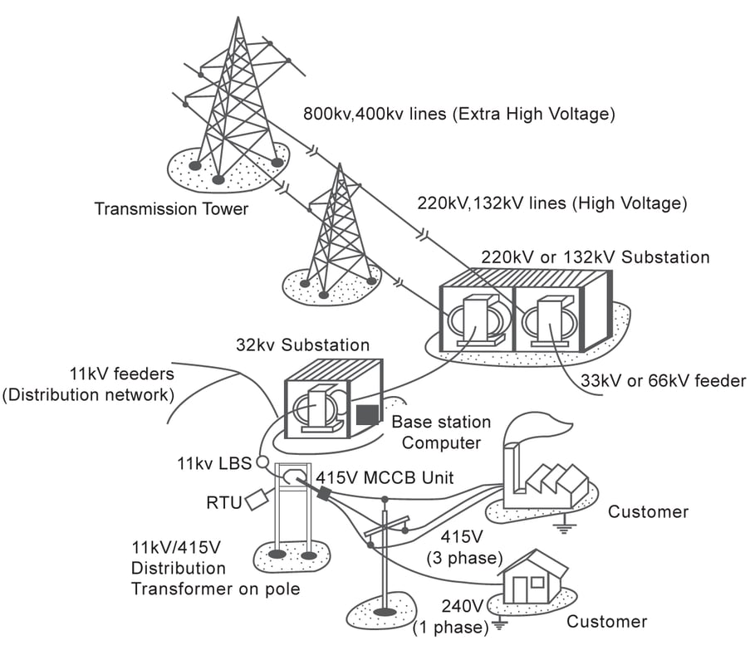
Introduction
Electric Transmission System Overview
Purpose: Interconnects power plants (generating stations) with loads.
System Type:
Three-phase AC system used for most transmission lines.
Consists of three-phase conductors
Operating Frequency:
60 Hz – U.S.
50 Hz – Europe, Australia, parts of Asia.
System Voltage: Defined as rms voltage between conductors (line-to-line voltage
Image: Source: Fuji electric
Electric Power Generation, Transmission, and Distribution by Leonard L. Grigsby (Chapter 8)

Slide 4
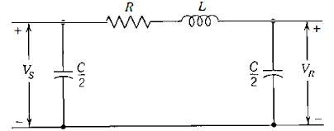
Types of Transmission lines
Short line : Length less than 80 km.
Shunt admittance is neglected
Lumped parameter model
Medium line: Length between 80 km to 240 km.
Shunt admittance needs to be considered
Lumped parameter model
Nominal π model
Nominal T model
Long line: Length longer than 240 km.
Distributed parameter model
Shunt admittance effect is important
Equivalent π or T equivalent can be derived
Single phase equivalent of a medium transmission line
Standards transmission voltage in India:
AC Transmission
765 kV
400 kV
220 kV
132 kV
HVDC Transmission
400 kV
500 kV
Power System Analysis by W. D. Stevenson (Chapter 6)
Power System Engineering by DP Kothari and IJ Nagrath

Slide 5
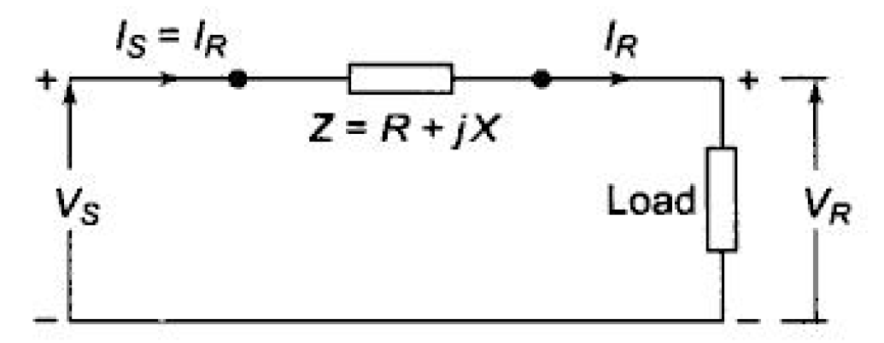
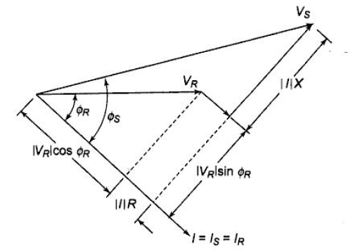
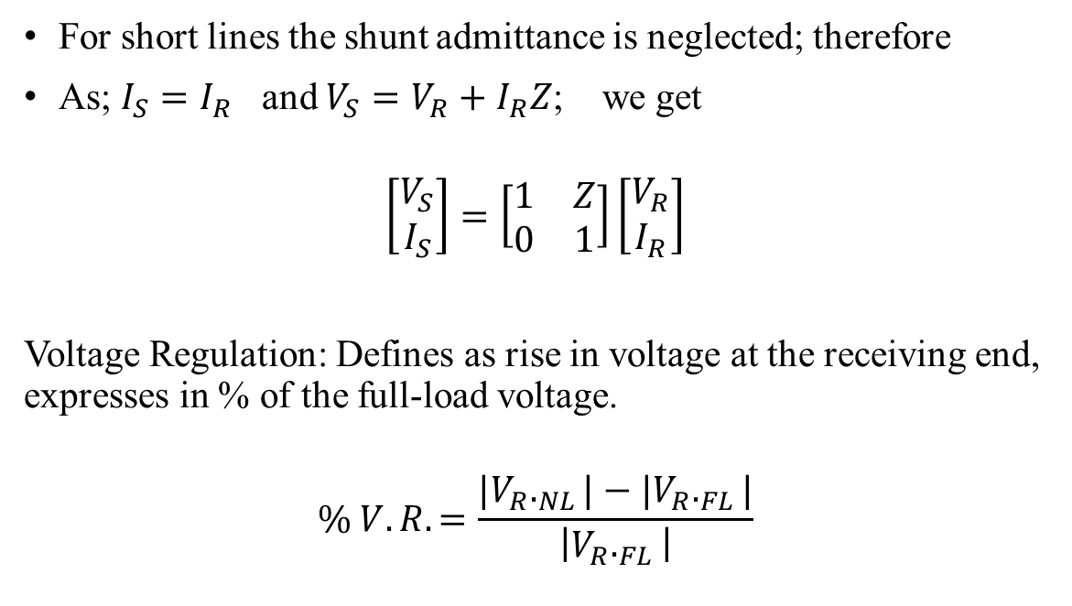
Short Transmission line
For short lines the shunt admittance is neglected; therefore
As; $I_{S}=I_{R}$ and $V_{S}=V_{R}+I_{R}Z$; we get
$$\left[\begin{matrix}V_{S} \\ I_{S}\end{matrix}\right]=\left[\begin{matrix}1 & Z \\ 0 & 1\end{matrix}\right]\left[\begin{matrix}V_{R} \\ I_{R}\end{matrix}\right]$$
Voltage Regulation: Defines as rise in voltage at the receiving end, expresses in % of the full-load voltage.
$$\% V.R.=\frac{{|V}_{R}._{NL}|−{|V}_{R}._{FL}|}{\left|V_{R}._{FL}\right|}$$
Single phase equivalent of a short line
Phasor diagram of a short line for lagging pf
Power System Analysis by W. D. Stevenson (Chapter 6)
Power System Engineering by DP Kothari and IJ Nagrath

Slide 6
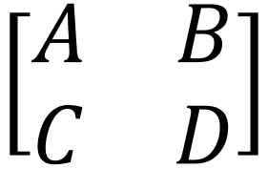
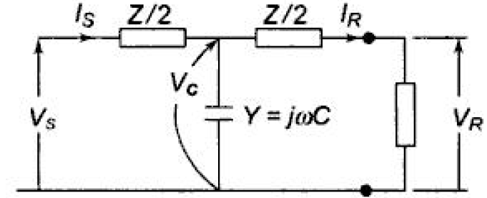
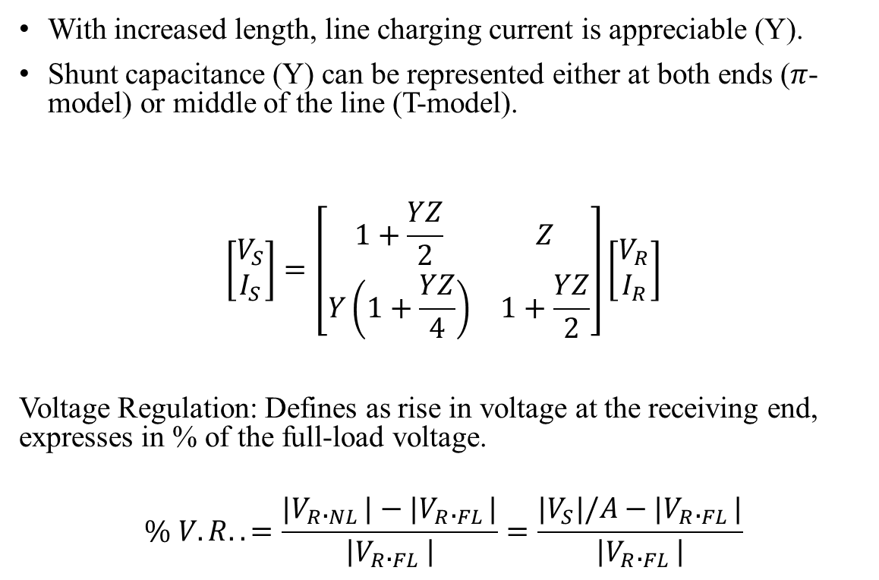
Medium Transmission line
With increased length, line charging current is appreciable (Y).
Shunt capacitance (Y) can be represented either at both ends ($π$- model) or middle of the line (T-model).
$$\left[\begin{matrix}V_{S} \\ I_{S}\end{matrix}\right]=\left[\begin{matrix}1+\frac{YZ}{2} & Z \\ Y\left(1+\frac{YZ}{4}\right) & 1+\frac{YZ}{2}\end{matrix}\right]\left[\begin{matrix}V_{R} \\ I_{R}\end{matrix}\right]$$
Voltage Regulation: Defines as rise in voltage at the receiving end, expresses in % of the full-load voltage.
$$\% V.R..=\frac{{|V}_{R}._{NL}|−{|V}_{R}._{FL}|}{\left|V_{R}._{FL}\right|}=\frac{{|V}_{S}|/A−{|V}_{R}._{FL}|}{\left|V_{R}._{FL}\right|}$$
Single phase equivalent of a short line
Phasor diagram of a short line for lagging pf
Power System Analysis by W. D. Stevenson (Chapter 6)
Power System Engineering by DP Kothari and IJ Nagrath

Slide 7
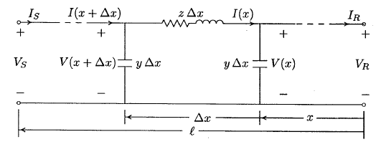
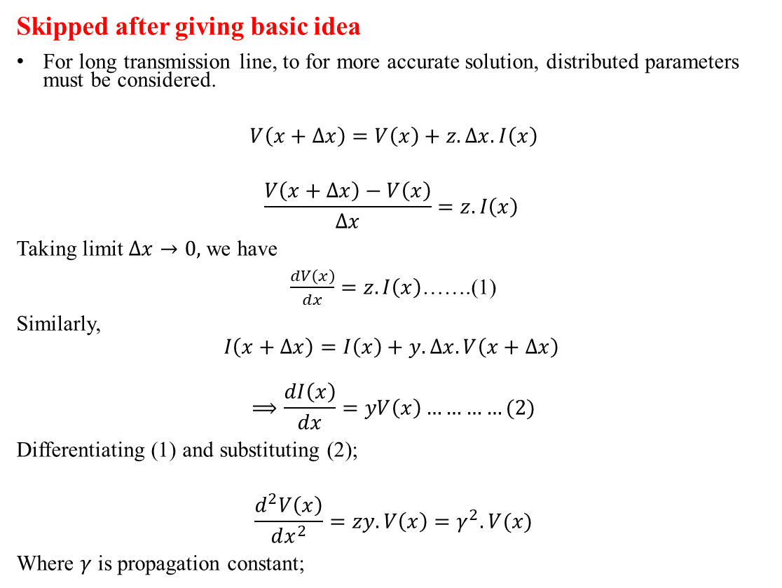
Long Transmission line
Skipped after giving basic idea
For long transmission line, to for more accurate solution, distributed parameters must be considered.
$$V\left(x+Δx\right)=V\left(x\right)+z.Δx.I\left(x\right)$$
$$\frac{V\left(x+Δx\right)−V\left(x\right)}{Δx}=z.I\left(x\right)$$
Taking limit $Δx→0,$ we have
$\frac{dV\left(x\right)}{dx}=z.I\left(x\right)$…….(1)
Similarly,
$$I\left(x+Δx\right)=I\left(x\right)+y.Δx.V\left(x+Δx\right)$$
$$\begin{aligned}⟹\frac{dI\left(x\right)}{dx}=yV\left(x\right)\#…………(2)\end{aligned}$$
Differentiating (1) and substituting (2);
$$\frac{d^{2}V\left(x\right)}{dx^{2}}=zy.V\left(x\right)=γ^{2}.V(x)$$
Where $γ$ is propagation constant;
Long line with distributed parameters
Power System Analysis by W. D. Stevenson (Chapter 6)
Power System Engineering by DP Kothari and IJ Nagrath

Slide 8
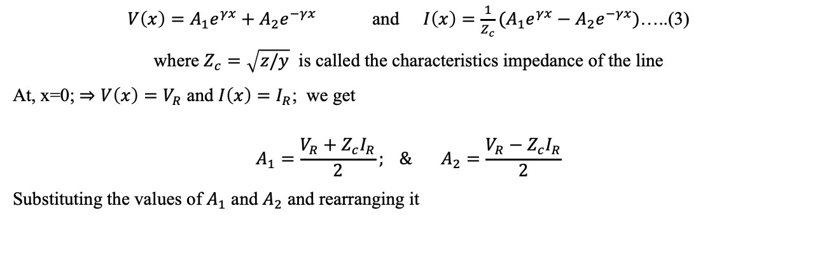
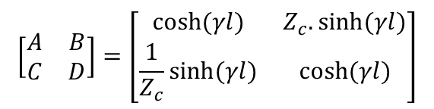

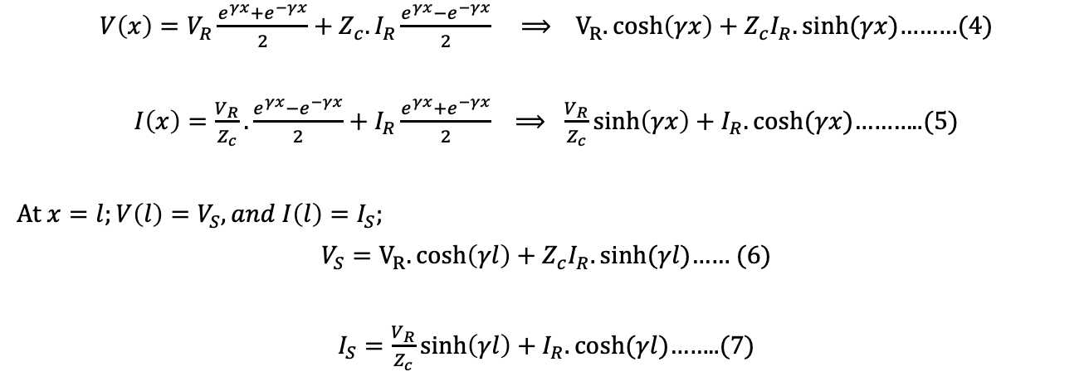
Long Transmission line
$V\left(x\right)=A_{1}e^{γx}+A_{2}e^{−γx}$ and $I\left(x\right)=\frac{1}{Z_{c}}{(A}_{1}e^{γx}−A_{2}e^{−γx})$…..(3)
where $Z_{c}=\sqrt{z/y}$ is called the characteristics impedance of the line
At, x=0; $⇒V\left(x\right)=V_{R}$ and $I\left(x\right)=I_{R}$; we get
$$A_{1}=\frac{V_{R}+Z_{c}I_{R}}{2}; \& A_{2}=\frac{V_{R}−Z_{c}I_{R}}{2}$$
Substituting the values of $A_{1}$ and $A_{2}$ and rearranging it
Long line with distributed parameters
$V\left(x\right)=V_{R}\frac{e^{γx}+e^{−γx}}{2}+Z_{c}{.I}_{R}\frac{e^{γx}−e^{−γx}}{2} ⟹ V_{R}.\cosh\left(γx\right)+Z_{c}I_{R}.sinh⁡(γx)$………(4)
$I\left(x\right)=\frac{V_{R}}{Z_{c}}.\frac{e^{γx}−e^{−γx}}{2}+I_{R}\frac{e^{γx}+e^{−γx}}{2} ⟹ \frac{V_{R}}{Z_{c}}\sinh\left(γx\right)+I_{R}.cosh⁡(γx)$………..(5)
At $x=l;V\left(l\right)=V_{S}, and I\left(l\right)=I_{S};$
$V_{S}=V_{R}.\cosh\left(γl\right)+Z_{c}I_{R}.sinh⁡(γl)$…… (6)
$I_{S}=\frac{V_{R}}{Z_{c}}\sinh\left(γl\right)+I_{R}.cosh⁡(γl)$……..(7)
$$⟹$$
$$\left[\begin{matrix}A & B \\ C & D\end{matrix}\right]=\left[\begin{matrix}cosh⁡(γl) & Z_{c}.sinh⁡(γl) \\ \frac{1}{Z_{c}}sinh⁡(γl) & cosh⁡(γl)\end{matrix}\right]$$

Slide 9
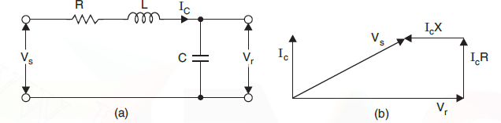
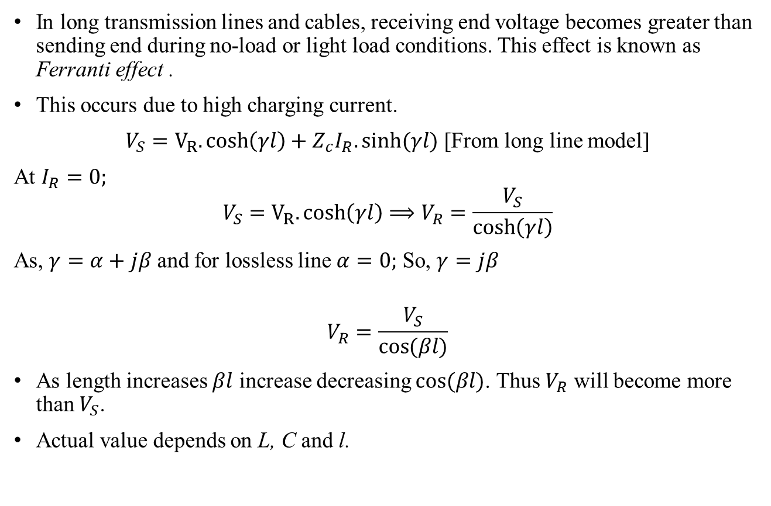
Ferranti Effect
In long transmission lines and cables, receiving end voltage becomes greater than sending end during no-load or light load conditions. This effect is known as Ferranti effect .
This occurs due to high charging current.
$V_{S}=V_{R}.\cosh\left(γl\right)+Z_{c}I_{R}.sinh⁡(γl)$ [From long line model]
At $I_{R}=0;$
$$V_{S}=V_{R}.\cosh\left(γl\right)⟹V_{R}=\frac{V_{S}}{\cosh\left(γl\right)}$$
As, $γ=α+jβ$ and for lossless line $α=0;$ So, $γ=jβ$
$$V_{R}=\frac{V_{S}}{\cos{(βl)}}$$
As length increases $βl$ increase decreasing $cos⁡(βl)$. Thus $V_{R}$ will become more than $V_{S}$.
Actual value depends on L, C and l.
Line representation (no load condition) and its phasor diagram
Power System Engineering by DP Kothari and IJ Nagrath (Chapter 5)

Slide 10
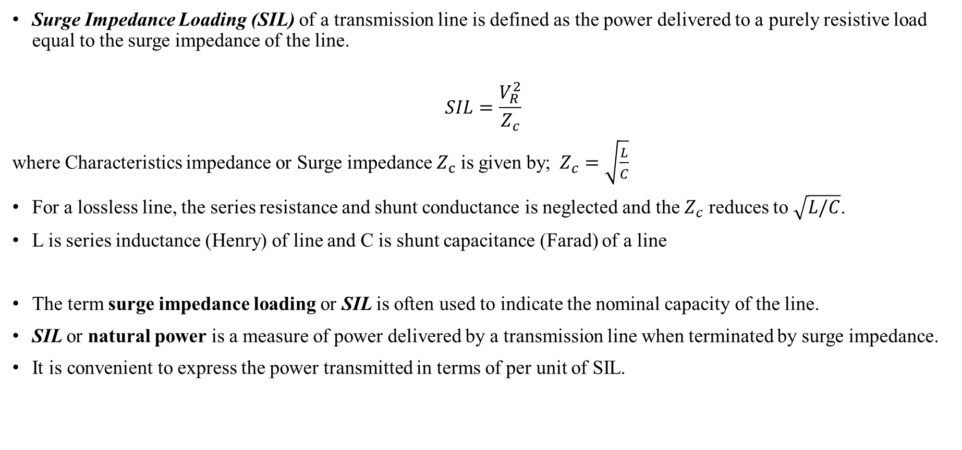
Surge Impedance loading
Surge Impedance Loading (SIL) of a transmission line is defined as the power delivered to a purely resistive load equal to the surge impedance of the line.
$$SIL=\frac{V_{R}^{2}}{Z_{c}}$$
where Characteristics impedance or Surge impedance $Z_{c}$ is given by; $Z_{c}=\sqrt{\frac{L}{C}}$
For a lossless line, the series resistance and shunt conductance is neglected and the $Z_{c}$ reduces to $\sqrt{L/C}$.
L is series inductance (Henry) of line and C is shunt capacitance (Farad) of a line
The term surge impedance loading or SIL is often used to indicate the nominal capacity of the line.
SIL or natural power is a measure of power delivered by a transmission line when terminated by surge impedance.
It is convenient to express the power transmitted in terms of per unit of SIL.
Power System Analysis by Haadi Saadat (Chapter 5)

Slide 11
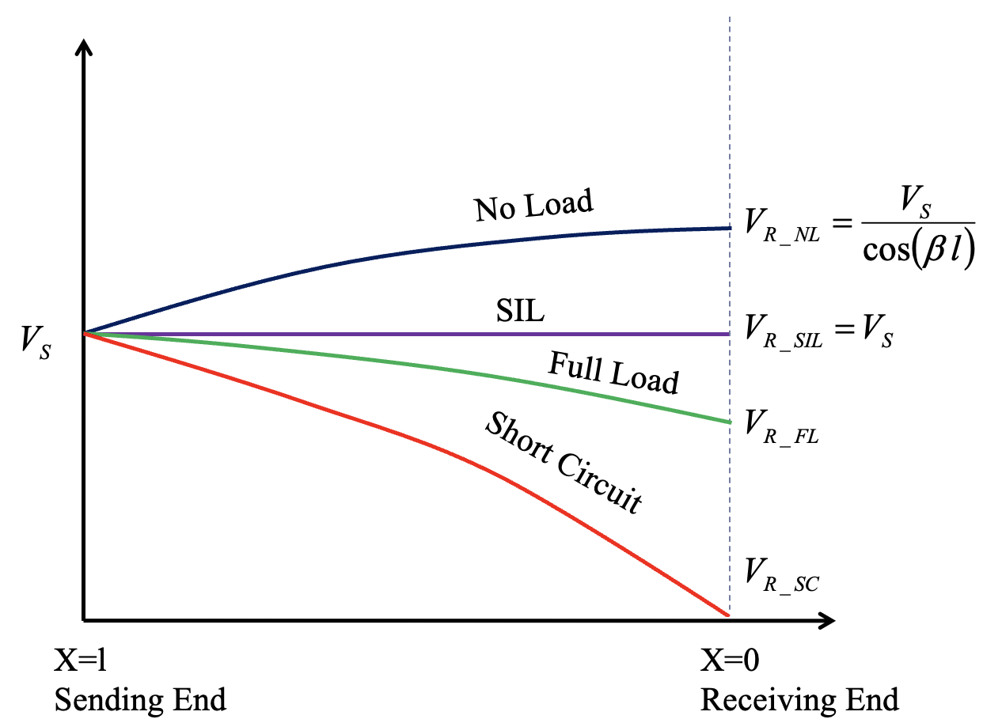
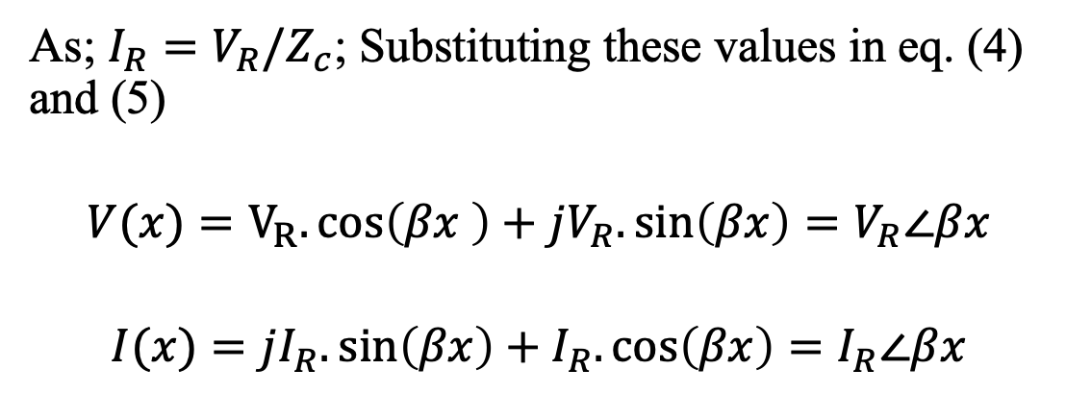
Surge Impedance loading
As; $I_{R}=V_{R}/Z_{c}$; Substituting these values in eq. (4) and (5)
$$V(x)=V_{R}.\cos\left(βx \right)+jV_{R}.\sin\left(βx\right)=V_{R}∠βx$$
$$I(x)=jI_{R}.\sin\left(βx\right)+I_{R}.\cos\left(βx\right)=I_{R}∠βx$$
From above equations, In a lossless line under surge impedance loading;
Voltage and currents are constant at any point of along the line in magnitude.
Power System Analysis by Haadi Saadat (Chapter 5)

Slide 12
Lecture 2: Cable Characteristics

Slide 13
Overhead vs. Underground Systems
Underground cables are technically advantages than the overhead lines
Not exposed to environmental conditions
Inductance is lower in cable so voltage drop is less
But cables are much more costlier than overhead lines for same dispatch capability and voltage
Cost of conductor and insulation is high
Capacitance is predominant in cables → large charging current (limits the length of cable).
Therefore, overhead lines for long transmission. Cables at distribution levels.
Cables are preferred in following conditions:
Public safety involved and low interference is required
Large populated cities
Submarine crossing, and substation and transformer connections
Non-availability of right of way to erect overhead systems

Slide 14
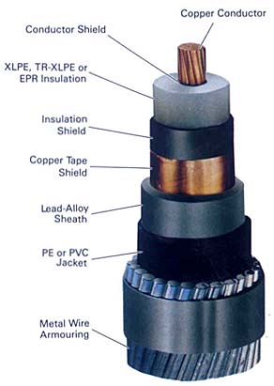
Components of power cable
Conductor for carrying current
Conductor shield to provide smooth radial electric field
Insulation to insulate high voltage conductor
Insulation shield (optional) to provide smooth radial electric field. Also act as hermitic seal of cable.
Metallic shield electric field, thermal, charging current, shock and RI
Metallic sheath and/or plastic jacket for mechanical protection. Metal sheath protect cable from water ingress.
Metal wire armoring (optional) for mechanical protection
Electric Power Generation, Transmission, and Distribution by Leonard L. Grigsby (Chapter 12)

Slide 15
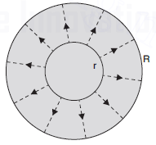
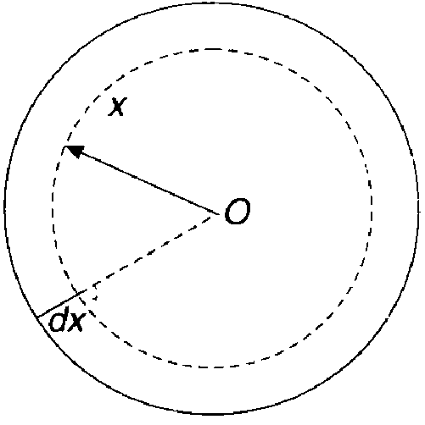
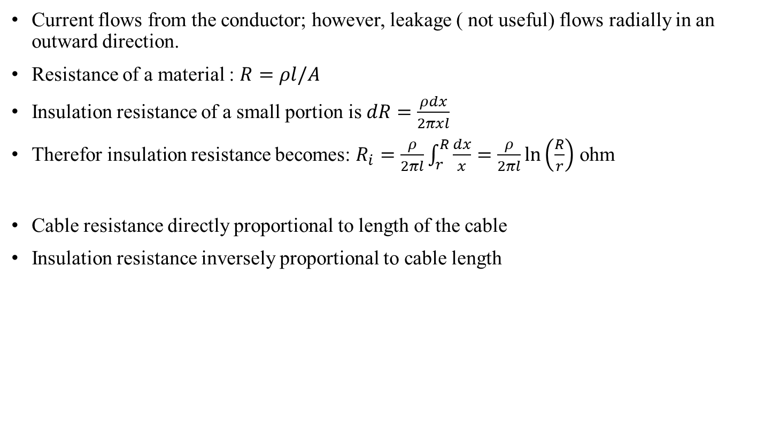
Insulation Resistance
Current flows from the conductor; however, leakage ( not useful) flows radially in an outward direction.
Resistance of a material : $R=ρl/A$
Insulation resistance of a small portion is $dR=\frac{ρdx}{2πxl}$
Therefor insulation resistance becomes: $R_{i}=\frac{ρ}{2πl}\int_{r}^{R}{\frac{dx}{x}=\frac{ρ}{2πl}\ln\left(\frac{R}{r}\right)}$ ohm
Cable resistance directly proportional to length of the cable
Insulation resistance inversely proportional to cable length
Insulation resistance of a cable
Electrical Power System by CL Wadhwa (Chapter 9)

Slide 16
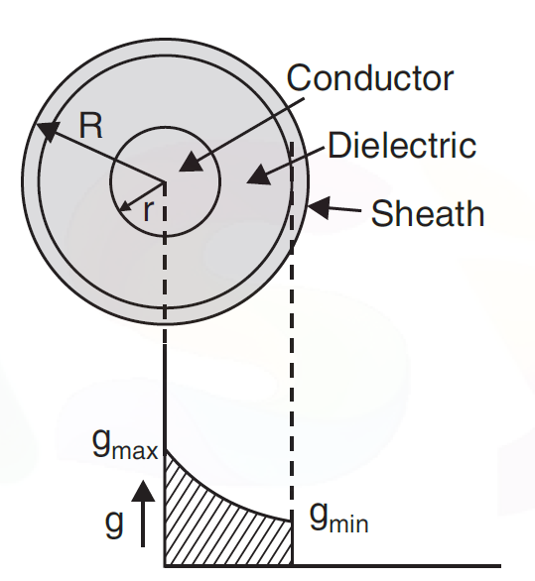
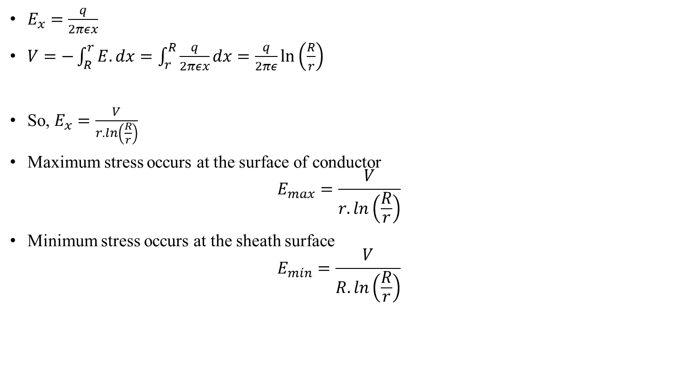
Electric stress in the cable
$E_{x}=\frac{q}{2πεx}$
$V=−\int_{R}^{r}{E.dx}=\int_{r}^{R}{\frac{q}{2πεx}dx=\frac{q}{2πε}\ln\left(\frac{R}{r}\right)}$
So, $E_{x}=\frac{V}{r.ln\left(\frac{R}{r}\right)}$
Maximum stress occurs at the surface of conductor
$$E_{max}=\frac{V}{r.ln\left(\frac{R}{r}\right)}$$
Minimum stress occurs at the sheath surface
$$E_{min}=\frac{V}{R.ln\left(\frac{R}{r}\right)}$$
Electric stress in a single core cable
Electrical Power System by CL Wadhwa (Chapter 9)

Slide 17
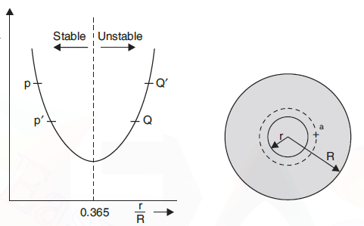
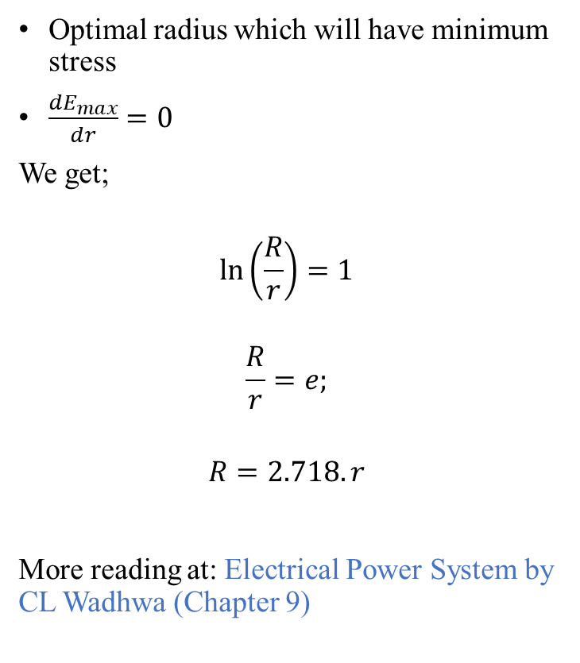
Electric stress in the cable (cont..)
Optimal radius which will have minimum stress
$\frac{dE_{max}}{dr}=0$
We get;
$$\ln\left(\frac{R}{r}\right)=1$$
$$\frac{R}{r}=e;$$
$$R=2.718.r$$
More reading at: Electrical Power System by CL Wadhwa (Chapter 9)
E
Electric stress in a single core cable
Variation of E as function of r/R
Electrical Power System by CL Wadhwa (Chapter 9)

Slide 18
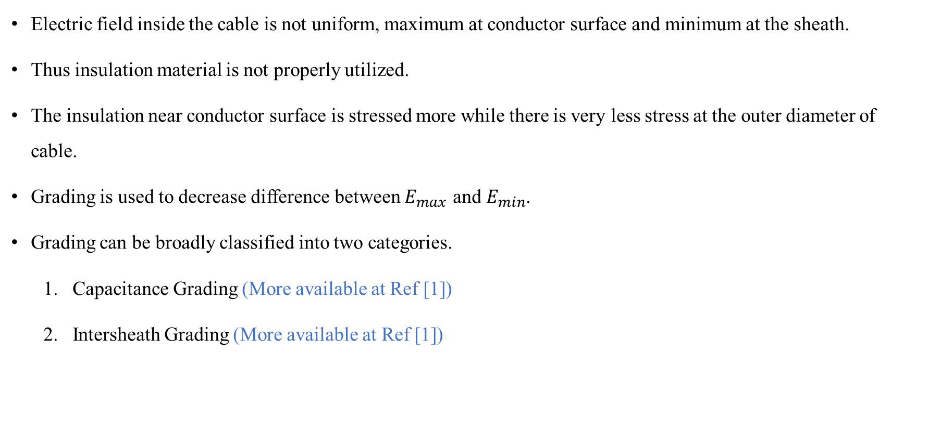
Grading of cables
Electric field inside the cable is not uniform, maximum at conductor surface and minimum at the sheath.
Thus insulation material is not properly utilized.
The insulation near conductor surface is stressed more while there is very less stress at the outer diameter of cable.
Grading is used to decrease difference between $E_{max}$ and $E_{min}$.
Grading can be broadly classified into two categories.
Capacitance Grading (More available at Ref [1])
Intersheath Grading (More available at Ref [1])
Ref [1] Electrical Power System by CL Wadhwa (Chapter 9)

Slide 19
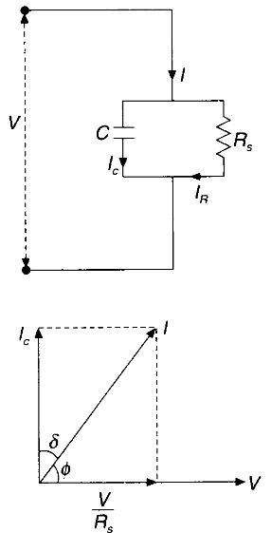
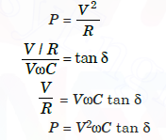
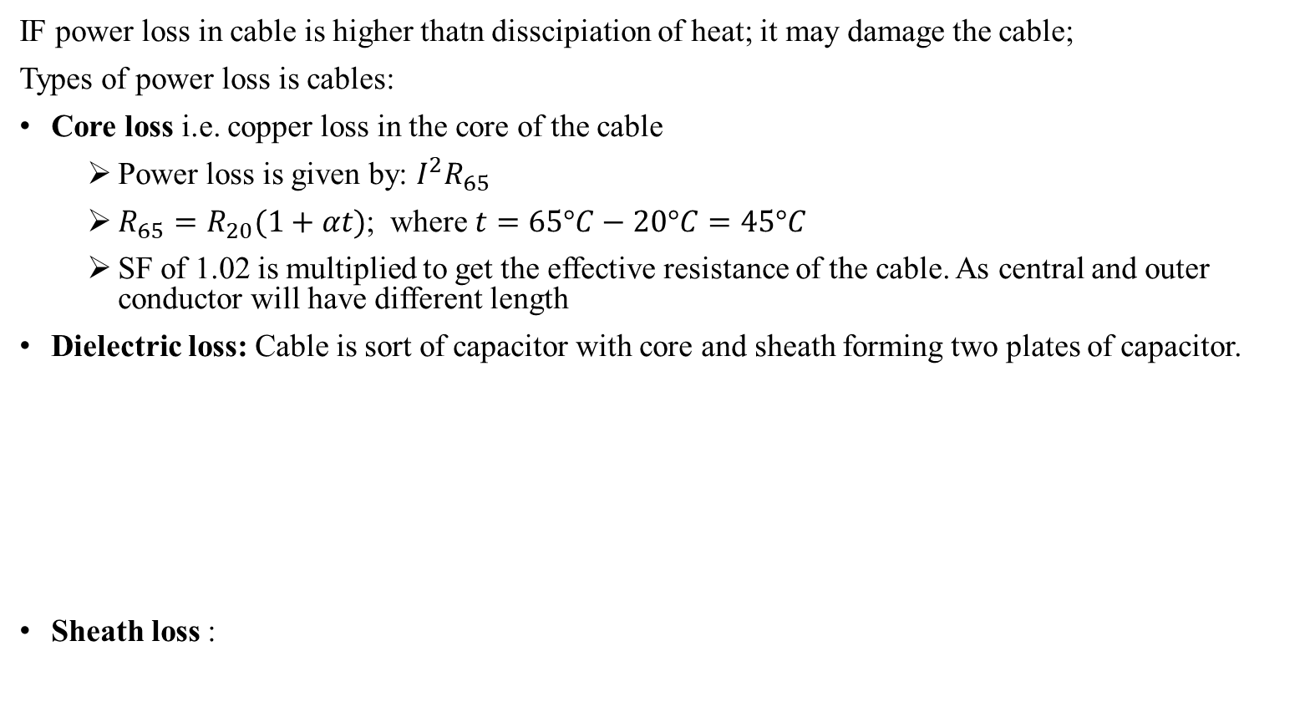
Heating of cables
IF power loss in cable is higher thatn disscipiation of heat; it may damage the cable;
Types of power loss is cables:
Core loss i.e. copper loss in the core of the cable
Power loss is given by: $I^{2}R_{65}$
$R_{65}=R_{20}(1+αt)$; where $t=65°C−20°C=45°C$
SF of 1.02 is multiplied to get the effective resistance of the cable. As central and outer conductor will have different length
Dielectric loss: Cable is sort of capacitor with core and sheath forming two plates of capacitor.
Sheath loss :
Equivalent circuit of cable and phasor
Ref [1] Electrical Power System by CL Wadhwa (Chapter 9)

Slide 20
Lecture 3 and 4: HVDC

Slide 21
HVDC
Main technical reasons for HVDC transmission are:
Reactive Power Loss: Inductive and capacitive elements of overhead lines and cables put limits to the transmission capacity and the transmission distance of AC transmission links.
Stability of system: Direct connection between two AC systems with the same frequency or a new connection within a meshed grid may be impossible because of system instability, too high short-circuit levels or undesirable power flow scenarios.
Current carrying Capacity: This limitation is of particular significance for cables. Depending on the required transmission capacity, the system frequency and the loss evaluation, the achievable transmission distance for an AC cable will be in the range of 40 to 100 km. It will mainly be limited by the charging current.
Operation and control: Direct connection between two AC systems with different frequencies is not possible. No control over power flow.
E. W. Kimbark, ’Direct Current Transmission-Vol.1’, Whley Interscience, New York 1971

Slide 22
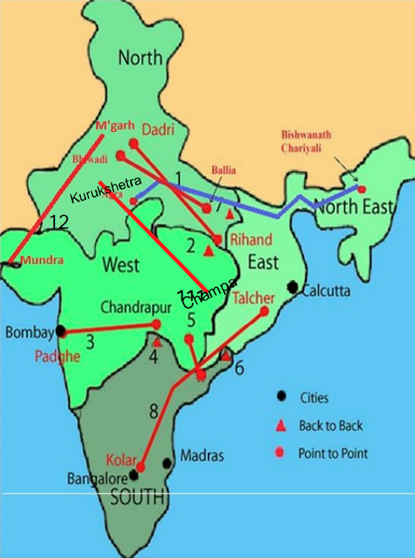
HVDC Scenario in India [1]
1 – Rihand-Dadri (+/- 500 kV,1500MW)
2 - Vindyachal (2 X250 MW)
3 - Chandrapur-Padghe (+/- 500kV,1500 MW) MSTCL
4 - Chandrapur-Ramagundam (2 X 500MW)
5 – Barsoor-Lower Sileru (100 kV, 100MW)
6 – Gajuwaka (1 X 500 MW + 1 X 500 MW )
7 - Sasaram (1 X 500 MW )
8 - Talcher-Kolar (+/- 500 kV, 2000MW, upgraded to 2500 MW)
9- Ballia-Bhiwadi (+/- 500 kV,2500MW)
10-NER-Agra (+/- 800 kV, 6000 MW MultiTerminal, under execution)
11. Champa-Kurukshetra (+/- 500kV, 6000 MW)
12. Mundra- Mohindergarh (+/- 500 kV, 2500MW)
https://www.adanienergysolutions.com/-/media/Project/Transmission/TechInnovation/documents/ATL-Article-on-HVDC.pdf?la=en

Slide 23
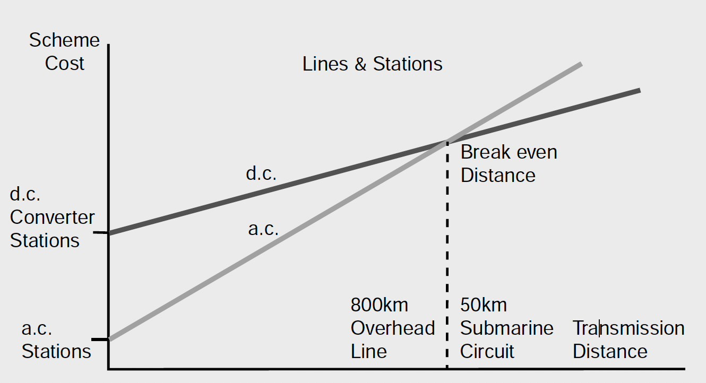
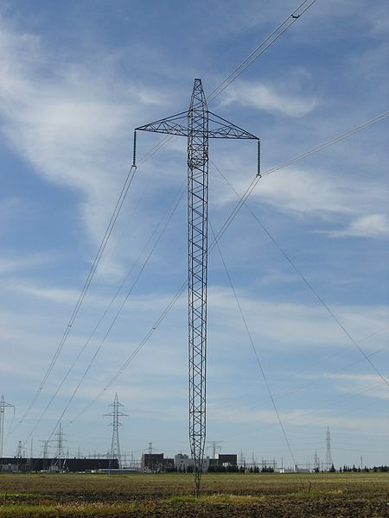
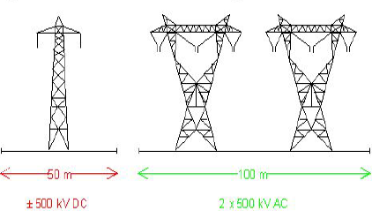
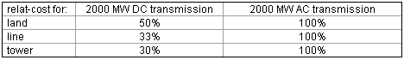
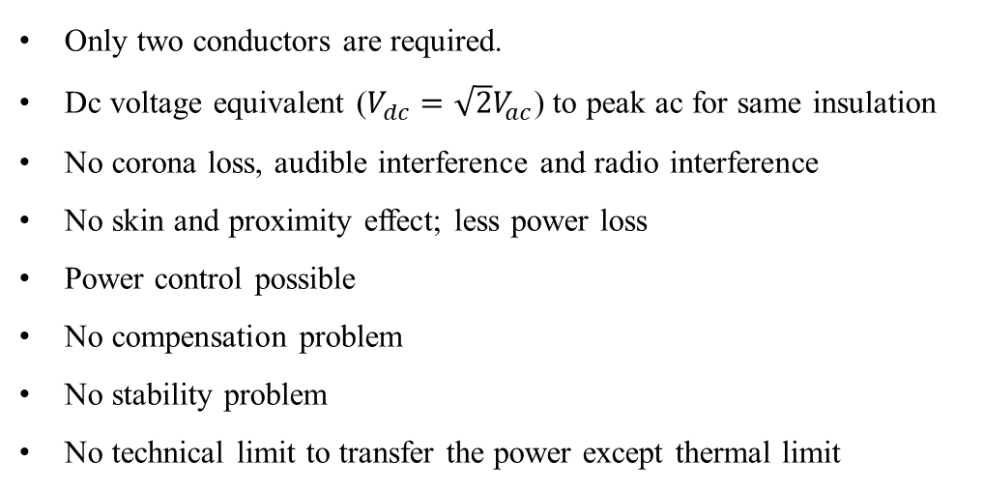
Advantages of HVDC
Only two conductors are required.
Dc voltage equivalent ($V_{dc}=\sqrt{2}V_{ac}$) to peak ac for same insulation
No corona loss, audible interference and radio interference
No skin and proximity effect; less power loss
Power control possible
No compensation problem
No stability problem
No technical limit to transfer the power except thermal limit
Less tower and land cost
For typical 2000 MW Transmission
E. W. Kimbark, ’Direct Current Transmission-Vol.1’, Whley Interscience, New York 1971

Slide 24
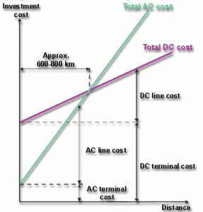
Advantages of HVDC (cpnt..)
Long distance transmission is cheaper in HVDC
Terminal cost
Line cost
Tower cost
Land cost
A HVDC transmission line costs less than an AC line for the same transmission capacity.
DC terminal cost is more expensive than AC terminal cost.
But above a certain distance, the so called "break-even distance", the HVDC alternative will always give the lowest cost.
Break even distance: 600 ~ 800 km
E. W. Kimbark, ’Direct Current Transmission-Vol.1’, Whley Interscience, New York 1971

Slide 25
Disadvantages of HVDC
Higher cost of converters stations compared to ac transformer
Filter requirement and associated equipment's to ensure acceptable waveform and p.f. (harmonics)
Limited ability to form multi-terminal d.c. network because of the need for coordination control and lack of commercial available d.c. circuit breakers.
No reactive power flow
Convertors can not be overloaded much
Reactive power absorbed by the converter
HVDC
cost
Distance

Slide 26
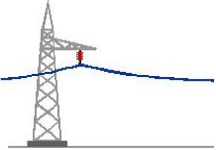
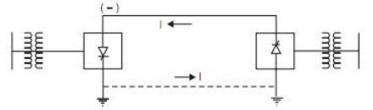
Types of HVDC links
Monopolar, 2. Bipolar, 3. Homopolar
Monopolar link:
Only one energized conductor normally of negative polarity (reduce corona loss and radio interference)
Ground or sea water used as return path
E. W. Kimbark, ’Direct Current Transmission-Vol.1’, Whley Interscience, New York 1971

Slide 27
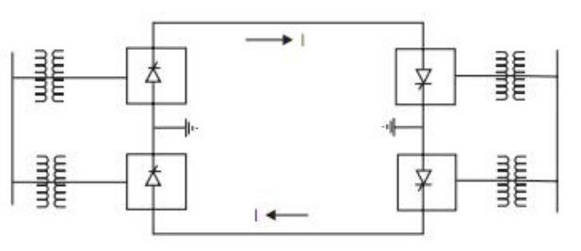
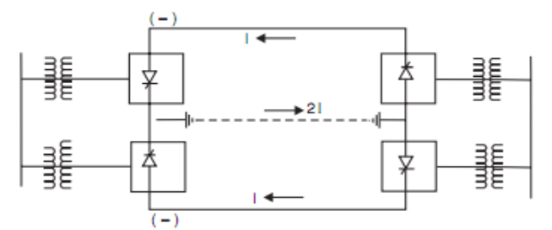
Types of HVDC links
Bipolar Link
Two conductors with polarities (+ve and -ve) represented as ±
Neutral points (junction between converters) are grounded (No current ideally)
In case of fault on one conductor, other conductor can be used with half of the rating (monopolar operation)
Homopolar Link
Two conductors with polarities (+ve and -ve) represented as ±
Operate with ground as return conductor
Neutral points (junction between converters) are grounded
Environmental Impact: Significant impact due to the use of the earth as the return path.
Limited Use: Less common in modern HVDC applications.
Bipolar Link
Homopolar Link
E. W. Kimbark, ’Direct Current Transmission-Vol.1’, Whley Interscience, New York 1971

Slide 28
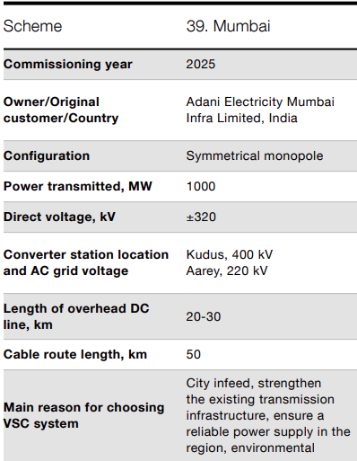
HVDC Light
Uses VSC (IGBT) compared to thyristor (HVDC Conventional)
Bi-directional power flow
AC Grid Support: Enhances robustness, stability, and controllability of existing AC grids.
Control of both active as well as reactive power
Applications: Grid interconnections, Offshore wind farms, Oil & gas platforms
Power Ratings: Typically, 50 MW to 2500 MW.
Transmission Medium: Overhead lines, Undersea/underground cables
HVDC light in India: Adani Electricity Mumbai Infra Ltd. [2]
First commercial HVDC Light project in Gotland, Sweden (1997)
[1] https://www.cablejoints.co.uk/upload/ABB-HVDC-Light--High-Voltage-Direct-Current--Cable-Catalogue.pdf
[2] https://publisher.hitachienergy.com/preview?DocumentID=POW0027&LanguageCode=en&DocumentPartId=001&Action=launch&DocumentRevisionId=AU

Slide 29
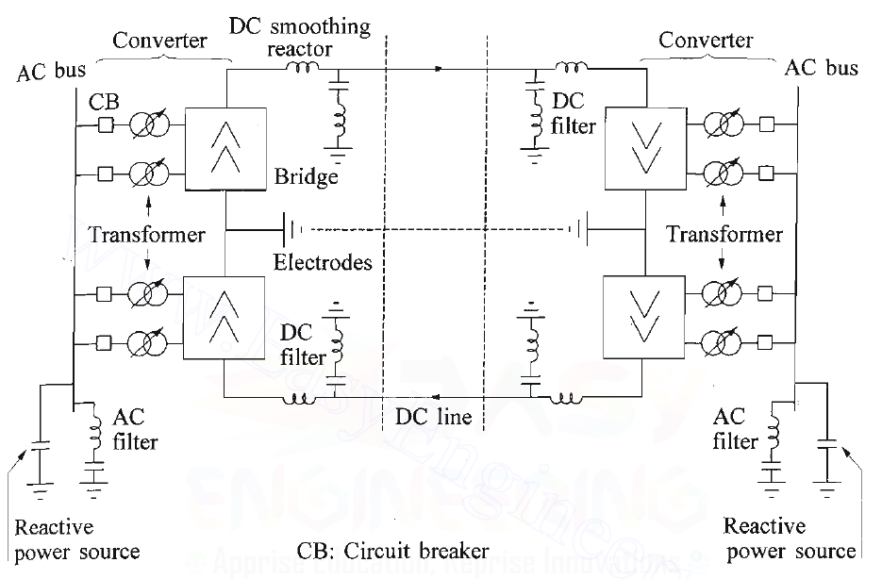
Components of HVDC transmission
Convertors
Convertor transformer
Smoothing reactor
AC filter
Overhead lines
Reactive power source
Earth electrode
DC Filters
Circuit Breakers
Schematic of a bipolar HVDC system identifying main components [1]
Prabha Kundur,’ Power System Stability and Control’, McGraw-Hill Inc. (Chapter 10)

Slide 30
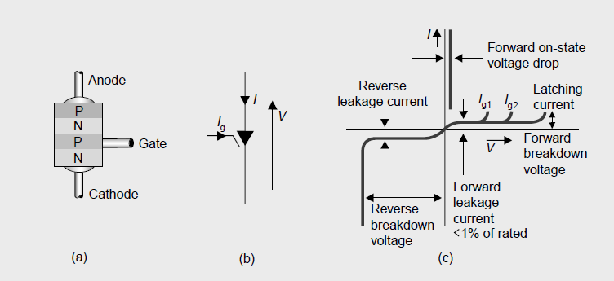
Semiconductor Valves for HVDC
Thyristor:
Structure of a four-layer thyristor. (b) Symbol, (c) Thyristor characteristic; Ig gate current to switch thyristor on at forward voltage
High-power thyristor silicon device (b) Thyristor valves in converter station [1]
B.M. Weedy , ‘Electric Power system’, Wiley (Chapter 9)

Slide 31
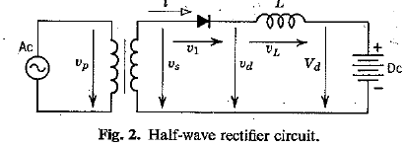
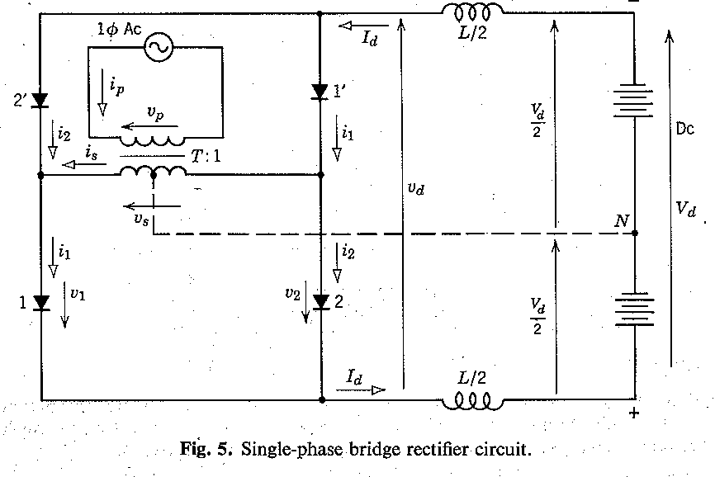
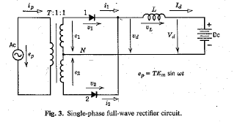
Single phase converters
Half wave rectifier :
Full wave rectifier:
Bridge Rectifier:
E. W. Kimbark, ’Direct Current Transmission-Vol.1’, Whley Interscience, New York 1971 (chapter 2)

Slide 32
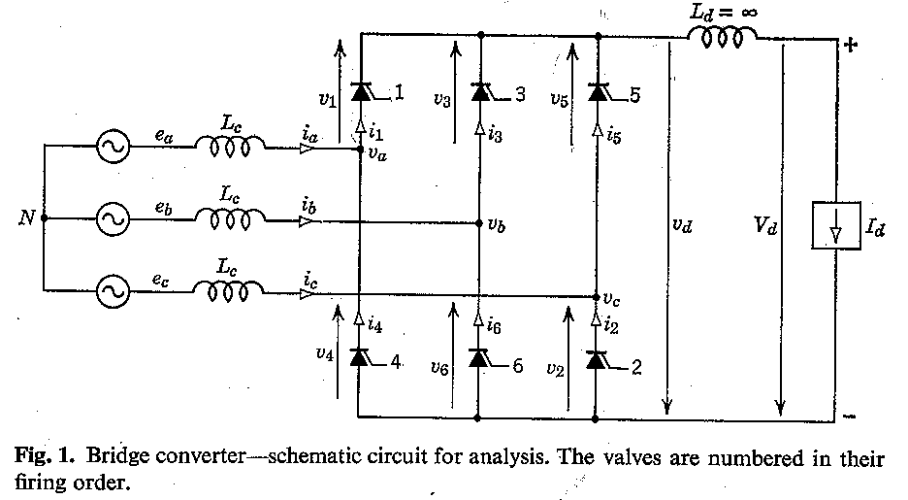
Three-phase converters
Three-phase one way rectifier:
Three-phase bridge rectifier:
E. W. Kimbark, ’Direct Current Transmission-Vol.1’, Whley Interscience, New York 1971 (chapter 2)

Slide 33
Three-phase converters
Three-phase one way rectifier:
Three-phase bridge rectifier:
E. W. Kimbark, ’Direct Current Transmission-Vol.1’, Whley Interscience, New York 1971 (chapter 2)

Slide 34
Lecture 5: Reactive power compensation

Slide 35
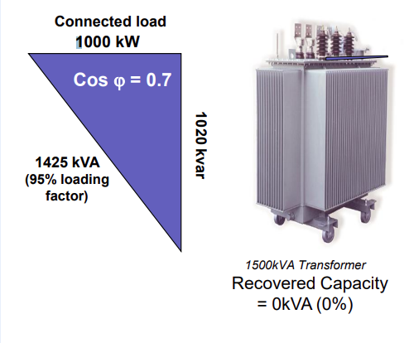
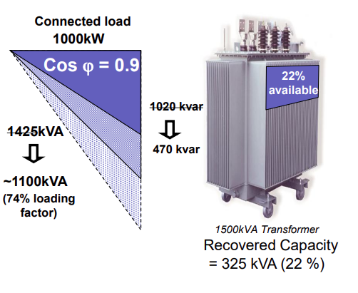
Need for Reactive power
Supports AC Voltage Levels: Maintains system voltage stability by compensating for voltage drops.
Enables Operation of Inductive Loads: Motors, transformers, and inductive devices require reactive power to sustain their magnetic fields.
Ensures Efficient Power Transfer: Helps in maintaining the required power factor, reducing energy losses in transmission lines.
Reduces Voltage Fluctuations: Prevents sudden voltage drops or spikes, ensuring stable power delivery.
Balances Power Flow in AC Systems: Reactive power helps maintain the balance between generation and consumption in the grid.
Essential for Transmission & Distribution: Transmission lines and transformers consume reactive power; supplying it ensures efficient operation.
Transformer operating at full load (S) due to low pf [1]
Transformer operating at full load (S) due to improved pf [1]
https://new.abb.com/docs/librariesprovider78/chile-documentos/jornadas-tecnicas-2013---presentaciones/4-jos%C3%A9-matias---reactive-power-compensation.pdf?sfvrsn=2

Slide 36

Advantages of improving pf
Benefits
Improves system power factor
Reduces network losses
Avoid penalty charges from utilities for excessive consumption of reactive power
Reduces cost and generates higher revenue for the customer
Increases system capacity and saves cost on new installations
Improves voltage regulation in the network
Increases power availability
https://new.abb.com/docs/librariesprovider78/chile-documentos/jornadas-tecnicas-2013---presentaciones/4-jos%C3%A9-matias---reactive-power-compensation.pdf?sfvrsn=2

Slide 37
Methods of Reactive power compensation
In general, four methods of injecting reactive power are available, involving the use of: [1]
Static shunt capacitors/reactors
Static series capacitors
Synchronous compensators
SVC and STATCOM
[1] B.M. Weedy , ‘Electric Power Systems’, Wiley (chapter 5)

Slide 38
Static shunt capacitors/reactors
Controls voltage rise in light-/no-load conditions.
Implemented using shunt reactors, shunt capacitors, SVCs, and synchronous condensers.
Shunt reactors are essential for Extra High Voltage (EHV) lines.
Shunt Capacitors: Widely used in lower voltage lines. (distribution levels) low voltage at distribution levels
Compensates unwanted voltage effects due to line capacitance.
Helps mitigate Ferranti effect and voltage rise at line terminations.
A transmission system with both series and shunt compensation
[1] Turan Gonen, ‘Electrical Power Transmission System Engineering’, CRC Press (chapter 3)

Slide 39


Static series capacitors
Voltage drop in the line reduces( gets compensated).
Prevents voltage collapse.
Steady-state power transfer increases -- inversely proportional X.
As a result of (ii) transient stability limit increases.
The benefits of the series capacitor compensator are associated with a problem.
Xc forms a series resonant circuit with the Xr: Myay lead to subsynchronous oscillations [2-3]
(a) Line with series capacitor, (b) Phasor diagram for fixed VR [2]
[1] Turan Gonen, ‘Electrical Power Transmission System Engineering’, CRC Press (chapter 3)
[2] B.M. Weedy , ‘Electric Power Systems’, Wiley (chapter 5)
[3] Modern Power System Analysis by DP Kothari and IJ Nagrath

Slide 40

Synchronous condensers
Ref [1]:
A synchronous machine without a prime mover that generates or absorbs reactive power.
Function: Controls reactive power by adjusting field excitation and maintaining system voltage stability.
Usage:
Often connected to transformer tertiary windings.
Mostly used in HVDC converter stations with weak systems.
Advantages Over Static Compensators:
Enhances the short-circuit capacity of the system.
Reactive power independent of system voltage.
Can exchange kinetic energy with the power system during swings.
Overload capability: 10–20% for up to 30 minutes.
Better voltage support than other shunt compensators.
(a) Line with series capacitor, (b) Phasor diagram for fixed VR [2]
[1] Prabha Kundur,’ Power System Stability and Control’, McGraw-Hill Inc. (Chapter 11)

Slide 41
Static VAR control (SVC)
SVCs are installed to solve these problems
1. Voltage regulation
2. Reduce voltage flicker caused by varying loads like arc furnaces, etc.
3. Increase the power transfer capacity of transmission systems
4. Increase transient stability limits of a power system
5. Increase damping of power oscillations
6. Reduce temporary overvoltage's
7. Damp sub synchronous oscillations
Is a Shunt-connected device
Vary reactive power by controlling the reactive impedance component using power electronics
Different types of SVC
Thyristor-controlled reactors (TCR) with fixed capacitors (FC)
Thyristor-switched capacitors (TSC)
Thyristor-controlled reactors in combination with mechanically or Thyristor switched capacitors
Electric Power Generation, Transmission, and Distribution by Leonard L. Grigsby (Chapter 18)

Slide 42

SVC (cont.)
If Voltage is Too High → Absorbs Reactive Power
TCR (Inductive Mode) is Activated
The thyristors control the current in a reactor, increasing inductive VAR absorption.
This reduces system voltage by counteracting capacitive effects in the grid.
If Voltage is Too Low → Supplies Reactive Power
TSC (Capacitive Mode) is Activated
Thyristors switch capacitor banks to inject capacitive VARs.
This increases system voltage by compensating for inductive loads.
May lead very large current if switches operated at high instantaneous voltage
Three versions of SVC. (a) TCR with fixed capacitor bank; (b) TCR with switched capacitor banks; and (c) thyristor-switched capacitor compensator
Electric Power Generation, Transmission, and Distribution by Leonard L. Grigsby (Chapter 18)

Slide 43


STATCOM
VSC connected to a power system using coupling reactance.
Uses transistor to systhesize sine wave at o/p
$V_{STATCOM} \& V_{terminal}$ are in phase: Real power zero: (small phase difference for losses in VSC)
$V_{STATCOM}>V_{terminal}$: Reactive power generated
$V_{STATCOM}<V_{terminal}$: Reactive power absorbed
STATCOMs can be controlled very fast and have a smaller physical equipment footprint than SVCs.
B.M. Weedy , ‘Electric Power Systems’, Wiley (chapter 5)

Slide 44
Lecture 6: Three-phase transformer

Slide 45

Transformer
Types of Transformers
Distribution Transformers:
Rated up to 500 kVA and 34.5 kV
Used for last-mile power distribution
Power Transformers:
Rated above 500 kVA and 34.5 kV
Used in transmission and substation networks
Transformer Cooling & Construction
Oil-immersed for insulation and cooling
Three-phase systems preferred for efficiency
Can be a single three-phase transformer or three single-phase transformers
Comparison:
Three-phase transformer: Lighter, cheaper, more efficient but complete failure risk
Three single-phase units: Higher flexibility, only one needs replacement if failed
Three-phase transformation. (a) Bank arrangement (b) core arrangement [2]
[1] Turan Gonen, ‘Electrical Power Transmission System Engineering’, CRC Press (chapter 2)
[2] Olle I. Elgerd , ‘Electric Energy Systems Theory’, T M H Edition, McGraw Hill Inc. (chapter 5)

Slide 46




Connection of 3-$φ$ transformer
$$Δ−Δ$$
Applications: Used where three-phase supply and heavy three-phase loads are involved like industrial plants etc [2]
Open Delta Mode – Works under unbalanced loads; two transformers can supply power if one fails.
Third-Harmonic Circulation – Prevents voltage distortion by keeping harmonics within the delta loop.
No Neutral Point – Not suitable when a neutral is required; used for low to moderate voltages.
[1] Power System Analysis by W. D. Stevenson (Chapter 2)
[2] Electric Machines by Ashfaq Hussain (Chapter 2)

Slide 47


Connection of 3-$φ$ transformer
$$Y−Y$$
Applications: Used for small transformers where balanced loads are involved.
The star-star (Y-Y) connection faces two major issues:
Without a neutral connection, the Y-Y setup doesn't handle uneven loads well. If there's no neutral, the voltage across each phase can become unbalanced if the load isn't even.
The Y-Y setup also has an issue with something called third harmonics. When everything is balanced, these harmonics match up with the magnetizing current in size and direction.
But without a neutral to balance them out, they add up and mess with the magnetic flow. This can lead to distorted voltages in the transformers.
To fix these problems with uneven loads and third harmonics in a Y-Y setup, you can connect the neutral solidly to the ground and add an extra set of windings called tertiary windings.
Phasor diagram can we drawn similar to $Δ−Δ$ connection
[1] Power System Analysis by W. D. Stevenson (Chapter 2)
[2] Electric Machines by Ashfaq Hussain (Chapter 2)

Slide 48


Connection of 3-$φ$ transformer
$Δ−Y$
Applications: Used for step down of voltages in distribution systems
[1] Power System Analysis by W. D. Stevenson (Chapter 2)

Slide 49



Connection of 3-$φ$ transformer
$$Y−Δ$$
$Y−Δ$ connection can be obtained by simply interchanging the primary and secondary roles in $Y−Δ$ connection
Applications: Used for voltage step-up in power transmission systems.
The Δ - Y connection or Y - Δ connection has no problem with unbalanced loads and third harmonics. The delta connection assures balanced phase voltages on the Y side and provides a path for the circulation of the third harmonics and their multiples without the use of a neutral wire.
[1] Power System Analysis by W. D. Stevenson (Chapter 2)
[2] Electric Machines by Ashfaq Hussain (Chapter 2)

Slide 50




Phase shift in 3-$φ$ transformer
Wiring diagram [1]
Terminal marking and phase displacement diagram [1]
$$V_{A}^{ (1)}=\frac{N_{1}}{N_{2}}V_{ab}^{ (1)}$$
$$V_{A}^{ (1)}=\frac{N_{1}}{N_{2}}\sqrt{3}V_{a}^{ (1)}∠30°$$
[1] https://testbook.com/question-answer/there-is-a-phase-difference-of______-between-the-c--60acc8a0aa66eb6da445fae9
[2] More read on: Power System Analysis by W. D. Stevenson (Chapter 2)

Slide 51
Factors Affecting Choice of Connection
The following factors affect the choice of three phase transformer connection:
Primary and secondary voltage levels
Loading condition (balanced/unbalanced)
Fault tolerance requirement
Grounding requirement
Harmonic content in the system
Space and cost constraints
Intended power transfer direction (Step up/Step down)
Based on the above factors, an appropriate three phase transformer connection is selected that best suits the application.
For example,
Delta-delta is preferred for heavy industry,
Delta-star for medium voltage distribution
And star-delta for transmission applications
[1] Electric Machines by Ashfaq Hussain (Chapter 2)

Slide 52

Reasons for Grounding
There are three basic reasons for grounding a power system: personal safety, protective device operation, and noise control.
Personal Safety:
Prevents electric shocks by ensuring a safe path for fault currents.
Prevents High Touch Potential: Avoids dangerous voltage differences between exposed metal parts and ground.
A missing safety ground can cause the equipment case to become live, creating a severe shock hazard.
Fault Scenario
A hot conductor inside the equipment touches the metal case.
Without grounding, the case is at full line voltage.
If an operator touches the case while standing on the ground, they complete the circuit, leading to electric shock.
Double Insulated Equipment – A Safer Alternative
Used in drills, saws, hairdryers, etc.
No exposed metal parts, so no risk of touch potential.
Even if internal faults occur, the outer housing remains non-conductive and safe.
Electric Power Generation, Transmission, and Distribution by Leonard L. Grigsby (Chapter 29)
Illustration of a dangerous touch potential situation

Slide 53

Reasons for Grounding
Protective device operation
Ground Path for Fault Current:
Protective devices work only if a continuous, low-impedance grounding path is available.
NEC requires the grounding path to handle fault currents without damage.
Earth Cannot Be a Grounding Path: NEC regulations mandate a dedicated grounding conductor.
Ground Path Impedance
$$Z=\frac{Maximum Voltage to Ground}{Overcurrent Protection Rating∗5}$$
Ensures protective devices operate correctly in case of faults.
Electric Power Generation, Transmission, and Distribution by Leonard L. Grigsby (Chapter 29)

Slide 54
Reasons for Grounding
Noise Control
Noise in Electrical Systems: Unwanted voltages/currents that interfere with sensitive equipment.
Potential Differences Between Grounding Systems:
Causes insulation stress and circulating currents, especially in communication cables.
Affects large facilities (e.g., college campuses) where separate buildings have different grounding systems.
Equipotential Grounding:
Reduces potential differences, preventing unwanted currents.
Uses ground grids, plates, and supplemental conductors to enhance performance.
Separation of Loads for Noise Control:
Best Practice: Keep ADP (Automatic Data Processing) units separate from motor loads.
Worst Case: Sharing circuits between ADP units and motors increases noise issues.
Optical Isolation: Prevents ground loop interference in communication systems.
Electric Power Generation, Transmission, and Distribution by Leonard L. Grigsby (Chapter 29)

Slide 55
Lecture 7: Power Quality

Slide 56
Definition of Power Quality
Electric utility may define PQ as reliability and manufacturers define PQ as those characteristics of the power supply that enable the equipment to work properly
The IEC 61000-1-1 Electromagnetic compatibility is the ability of a system or an equipment to function satisfactorily in its electromagnetic environment without introducing intolerable electromagnetic disturbances to anything in that environment
IEEE std 1159-2009 The term power quality refers to a wide variety of electromagnetic phenomena that characterize the voltage and current at a given time and at a given location on the power system
Dungan, ‘Electrical Power Systems Quality’, Mc Graww Hill

Slide 57
Why so much concern ?
Industrial Impact [1]
Sensitive automation & energy-efficient equipment.
Power disturbances → Production downtime & financial losses
Semiconductor industry → SEMI Standard F-47 for voltage sag immunity [2]
Utility Perspective [1]
Customer retention crucial in deregulated markets.
Poor service → Revenue loss & reputation damage.
Legal & regulatory costs due to complaints and interventions.
Residential Impact [1]
No direct financial loss, but high dependency on technology.
Frequent complaints & service costs for utilities.
Equipment Supplier Challenges [1]
Cost pressures prevent adding power-quality features.
End users must ensure equipment meets power performance standards.
[1] Dungan, ‘Electrical Power Systems Quality’, Mc Graww Hill
[2] Application Note SEMI F47: Clean DC Power to Ensure High Quality Semiconductor Fabrication

Slide 58

Power Quality Phenomenon
Any deviations in voltage waveform or current waveform or both is called as “power quality phenomenon” or a “power quality disturbance”.
IEEE Standards coordinating committee in association with PES, IAS standardize the definitions of power quality
IEC uses the term “electromagnetic compatibility”
a piece of equipment should be able to operate normally in its environment
it should not pollute the environment too much
[1] Math H. J. Bollen, ‘Understanding power quality problems’, Wiley Interscience (Chapter 1)

Slide 59

Electromagnetic phenomenon
IEC 61000-2-5 (1995)- classifies electromagnetic phenomena into the groups shown below
[1] Dungan, ‘Electrical Power Systems Quality’, Mc Graww Hill (Chapter 2)

Slide 60


Electromagnetic phenomenon
IEEE 1159
Categories and Characteristics of Power System Electromagnetic Phenomena
Note:
s =second, ns =nanosecond, $μ$s =microsecond, ms=millisecond, kHz = kilohertz, MHz = megahertz, min=minute, pu =per unit.
[1] Dungan, ‘Electrical Power Systems Quality’, Mc Graww Hill (Chapter 2)

Slide 61

Power Quality Disturbances
Transients: undesirable momentary deviation of the supply voltage or load current for very short duration.
Also known as surges or spikes.
Impulsive transient: a sudden, non-power frequency change in the steady-state condition of voltage, current, or both that is unidirectional in polarity.
Causes: Load switching, lightening
Generally not conducted far from the source
Characterized by rise time, fall time, and spectral content.
Lightning stroke current impulsive transient
[1] Dungan, ‘Electrical Power Systems Quality’, Mc Graww Hill (Chapter 2)

Slide 62

Power Quality Disturbances
Oscillatory transients: A sudden, non-power frequency change in the steady state condition of voltage, current, or both, that includes both positive and negative polarity values
High-frequency oscillatory transient: greater than 500 kHz
Medium frequency oscillatory transient: between 5 kHz to 500 kHz
Low frequency oscillatory: transient less than 5 kHz
Causes impulsive transient, capacitor cable switching, arcing contacts
Characterized by magnitude, duration, and spectral content
Oscillatory transient due to back-to-back capacitor switching
Low-frequency oscillatory transient caused by capacitor bank energization 34.5-kV bus voltage.
[1] Dungan, ‘Electrical Power Systems Quality’, Mc Graww Hill (Chapter 2)

Slide 63

Power Quality Disturbances
Short duration rms variations: undesirable deviation of the supply voltage from the nominal value for a duration of 0.5 cycles to 1 min
Instantaneous, momentary, or temporary depending on its duration
Causes faults, energization of large loads which require high starting currents, or intermittent loose connections in power wiring
Interruption: Complete disappearance of the voltage < 0.1 pu on one or more phases
Causes: utility equipment failure, system faults, control malfunction
Characterized by magnitude and duration
Duration is determined by the operating time of the utility protective device
Three-phase rms voltages for a momentary interruption due to a fault and subsequent recloser operation.
[1] Dungan, ‘Electrical Power Systems Quality’, Mc Graww Hill (Chapter 2)

Slide 64


Power Quality Disturbances
Sag: A sag is a decrease in rms voltage to between 0.1 pu and 0.9 pu
Sag refers to the resulting voltage
Dip is contrary to it
Causes: energizing heavy load, ground fault, etc
Characterized by magnitude and duration
Swell: A swell is an increase to between 1.1 to 1.8 pu in rms voltage at the power frequency
Causes sudden load reduction, fault, energizing a large capacitor bank, etc
Can be characterized by magnitude (rms value) and duration
Voltage sag caused by an SLG fault
Instantaneous voltage swell caused by an SLG fault.
[1] Dungan, ‘Electrical Power Systems Quality’, Mc Graww Hill (Chapter 2)

Slide 65
Power Quality Disturbances
Long duration rms variations: undesirable rms deviation of the supply voltage at a power frequency longer than 1 min
Causes: load variations and system switching operation
Over Voltage: An overvoltage is an increase in the rms ac voltage greater than 110% at the power frequency for a duration longer than 1 minute.
Causes: Overvoltage is usually the result of load switching (e.g., switching off a large load or energizing a capacitor bank).
Incorrect tap settings on transformers can also result in system overvoltage.
Under Voltage: An under voltage is a decrease in the rms ac voltage to less than 90 % at the power frequency for a duration longer than 1 min.
Causes: A load switching on or a capacitor bank switching off.
Sustained Interruptions: When the supply voltage becomes zero for a period of time in excess of 1 minute, the long-duration voltage variation is considered a sustained interruption.
Voltage interruptions longer than 1 min are often permanent and require human intervention to repair the system for restoration.
[1] Dungan, ‘Electrical Power Systems Quality’, Mc Graww Hill (Chapter 2)

Slide 66
Power Quality Disturbances
Voltage Imbalance
Waveform distortion
DC offcet
Harmonics
Interharmonics
Notching
Noise
Voltage fluctuation
Power Frequency Variation
[1] Dungan, ‘Electrical Power Systems Quality’, Mc Graww Hill (Chapter 2)

